Slide 1
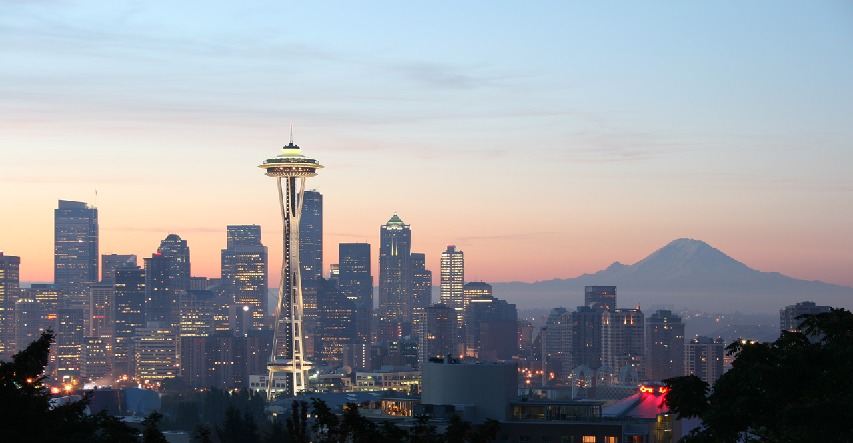
United States Traveling Cities Recommendation
Chen Chen, Hongmei Zong, Zishan Qin

Slide 2
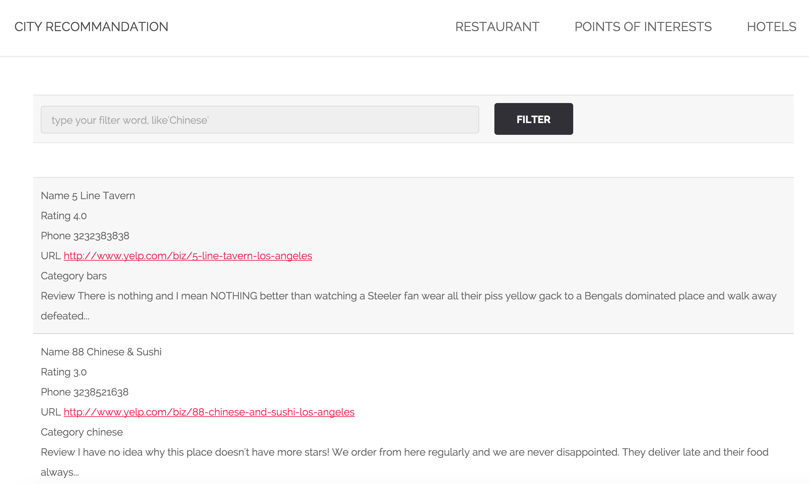
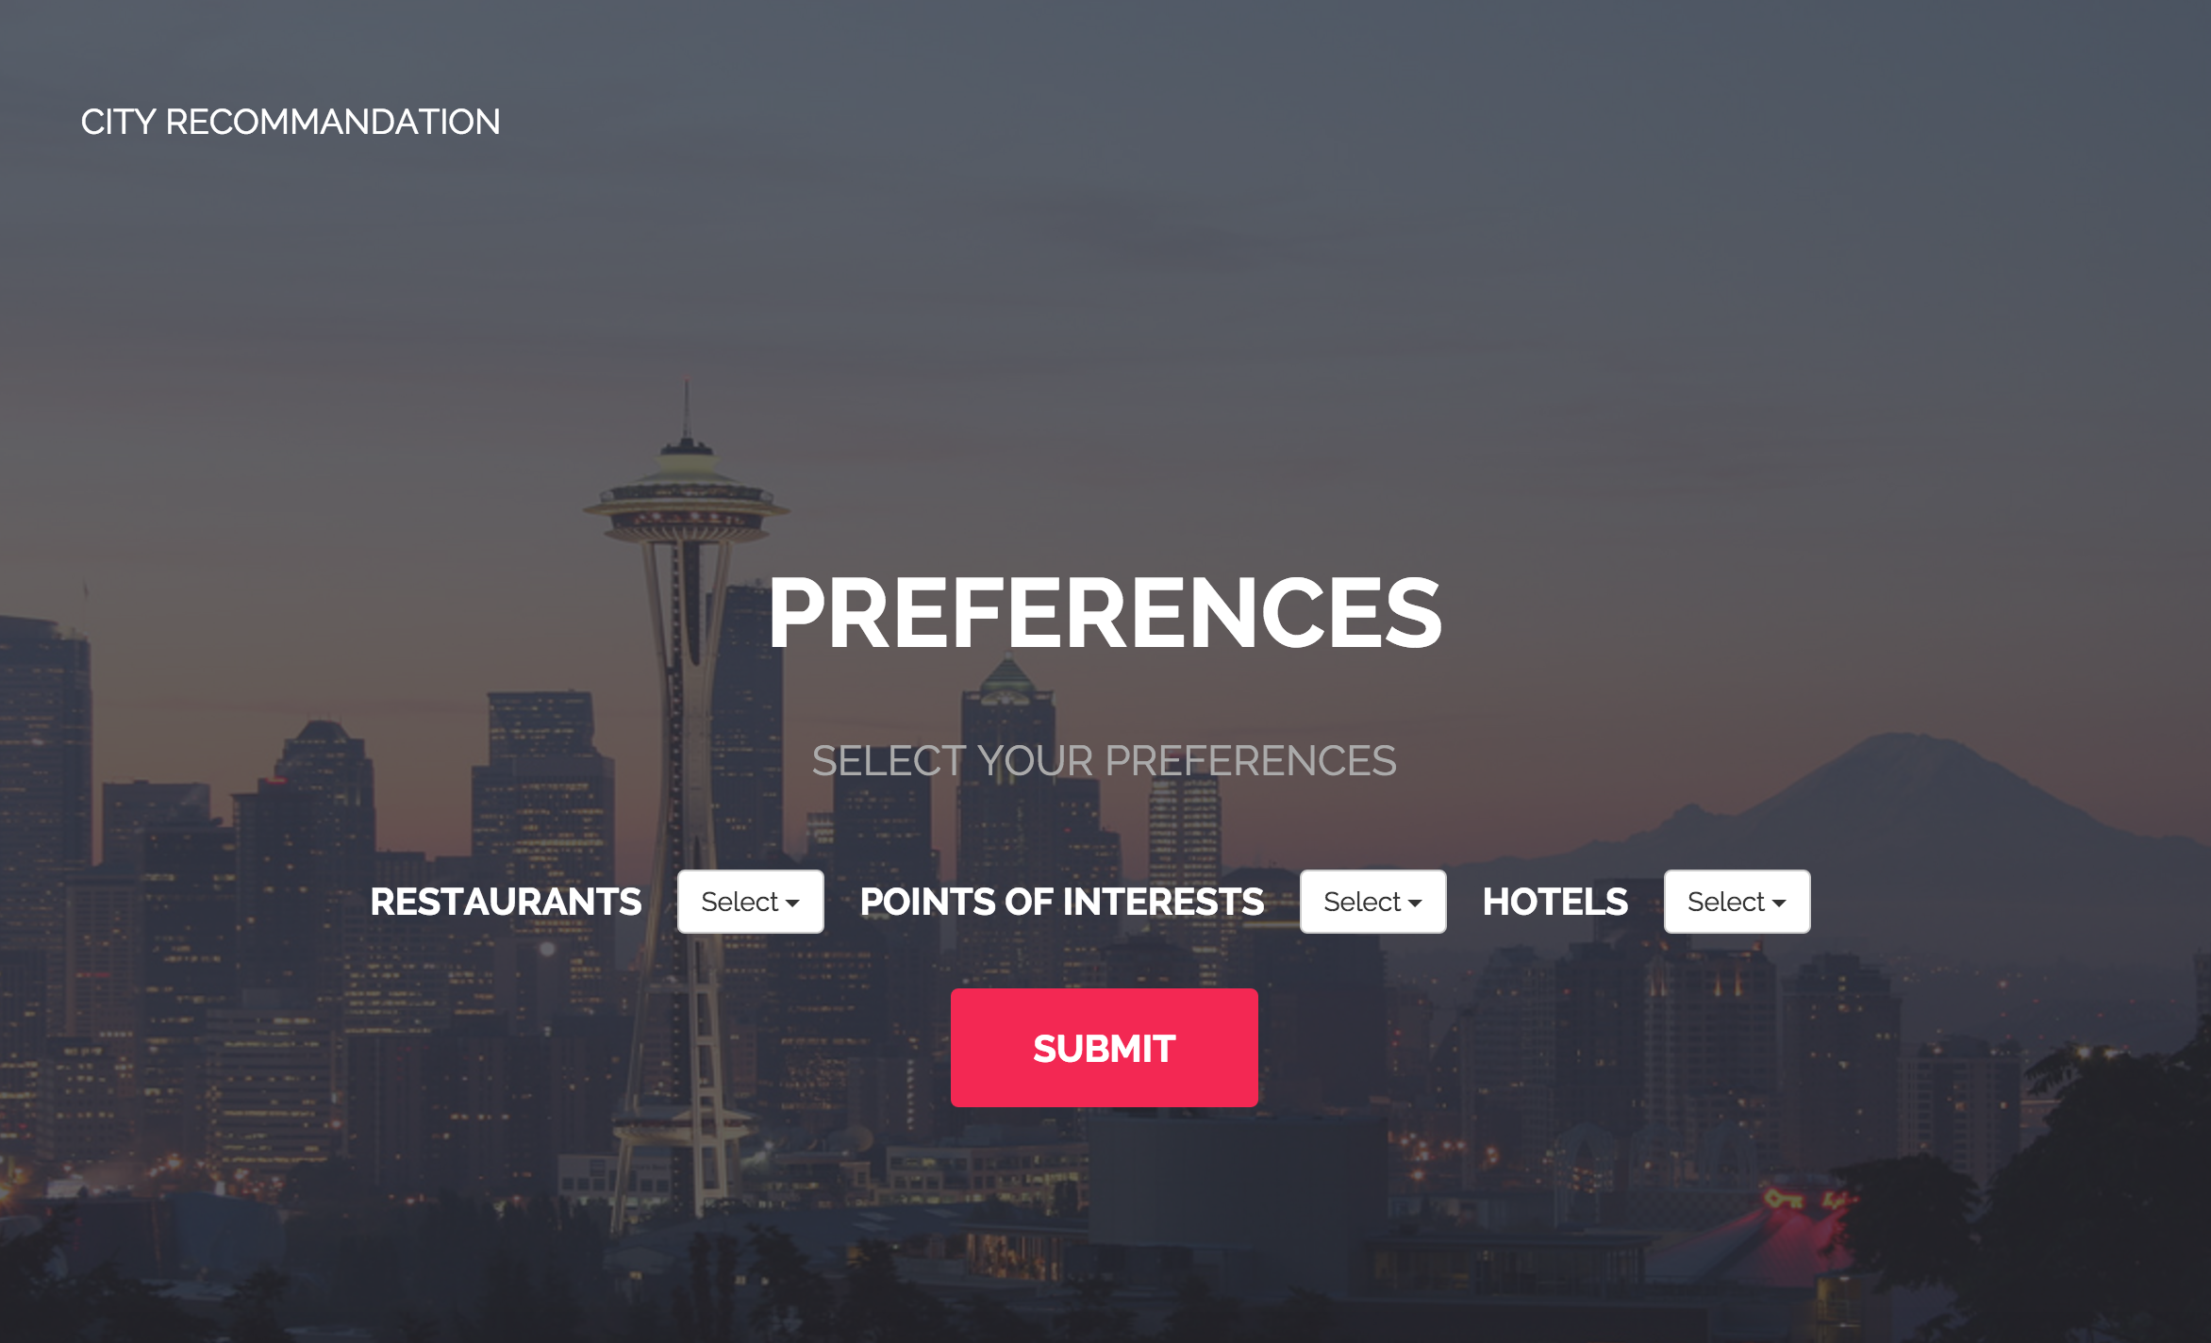
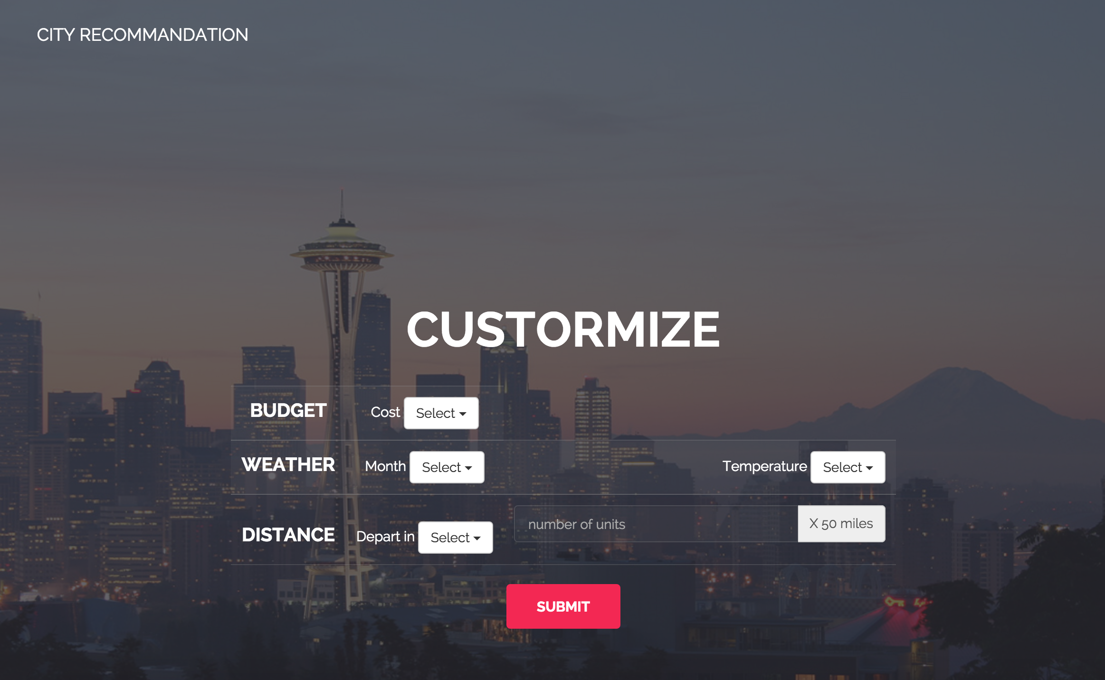
Goals of the Project
Offer User a web application to plan their traveling trips
Allow user to customize their searching conditions
User can get detailed business information(name, address, phone number, url etc.)
Practice the ability to develop an application system and improve problem solving skills

Slide 3
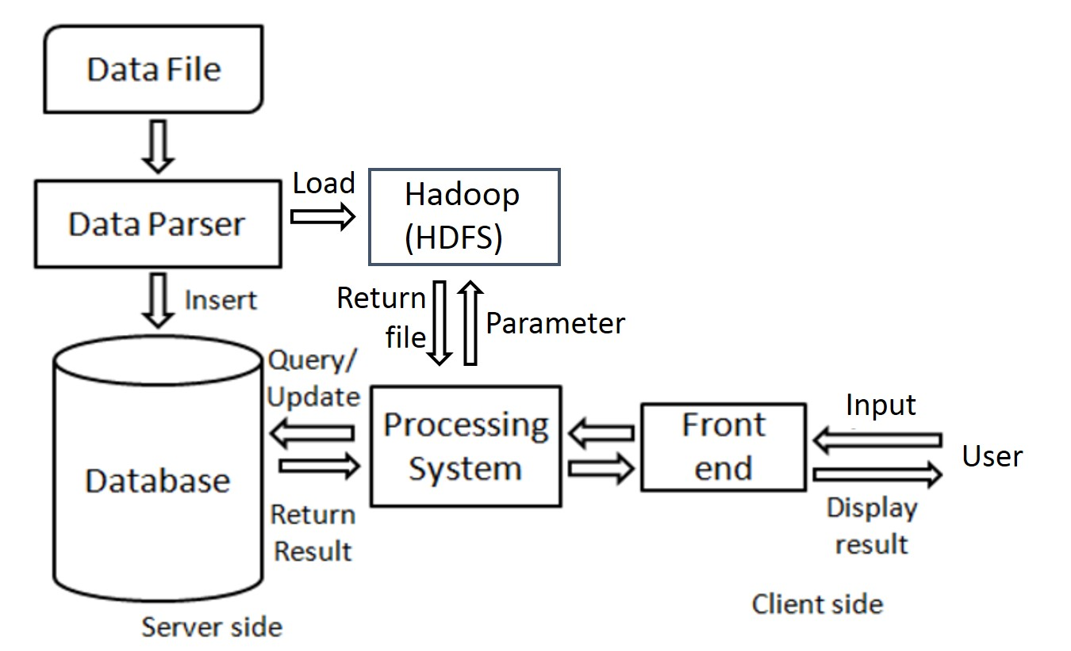
System Architecture

Slide 4
Data Analysis on Hadoop
Two phases of Map-Reduce :
Input: parsed dataset; Output: <city_name cate_scr1,cate_scr2,cate_scr3>
Input: city with cate_score Output: <city_name city_score>

Slide 5
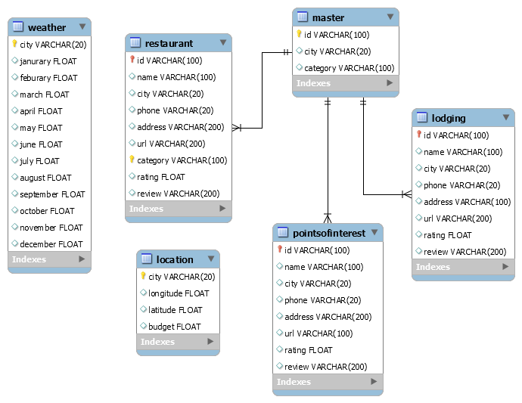
Database Design

Slide 6
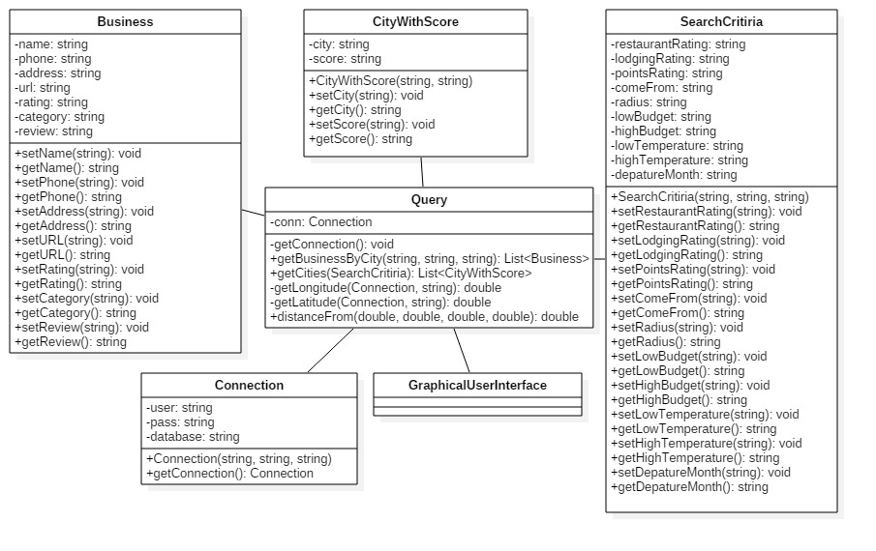
System Workflow

Slide 7
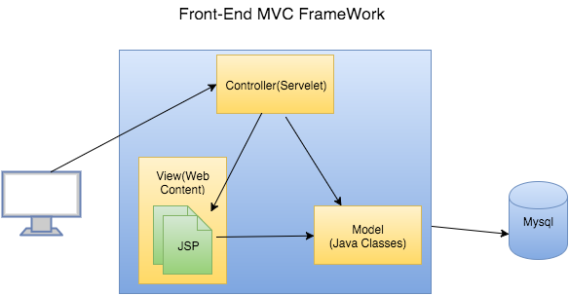
User Interface
Dynamic Web Application
MVC Architecture
Techniques: JSP, Servelet programming, HTML, CSS , Javascript(Jquery, Ajax)

Slide 8
Future Work
Extend our traveling cities from United States to International range.
Periodically update our dataset (for example, 2 weeks)
Use web crawler to get more business data instead of using Yelp API.

Slide 9
Demo

